Slide 1


Student Marks and Grades
Problem Understanding & Project Objective
Name - Vidhan
Collage - Indian Institute of Technology ,Patna
Roll No - 2312res733

Slide 2
01 - Problem Understanding & Project Objective
Problem Statement: Design a Python program to calculate and summarize student marks and grades.
Key Objectives:
Calculate total and average marks for each student.
Assign grades based on marks.
Determine class average and identify the class topper.
Predict student marks using machine learning models based on study habits.
Input: Student data (number of courses, time study, marks).

Slide 3
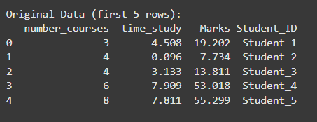
02 - Data Input Handling
Initial Data Snapshot
Data Source: Student_Marks.csv file.
Structure:
Number_courses: Number of courses a student is taking.
Time_study: Hours spent studying.
Marks: Student's final marks.

Slide 4
03 - Data Cleaning & Preprocessing
Tips
Importance: Why is data cleaning crucial? (Ensures data quality and model accuracy).
Steps Performed :
Missing Values: Checked for null values using df.isnull().sum().
Data Types: Verified correct data types using df.info().
Result: Clean and ready data for analysis.

Slide 5

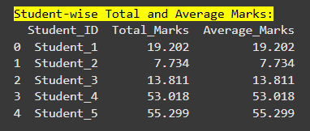
04 - Student-wise Summary & Grade Assignment
Calculations:
Total Marks: Directly from the 'Marks' column (as per dataset structure).
Average Marks: Same as 'Marks' column.
Grade Assignment Logic
A: 90-100
B: 80-89
C: 70-79
D: 60-69
F: Below 60

Slide 6
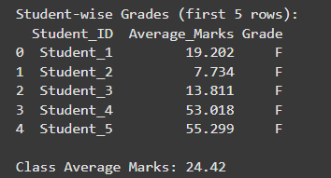
05 - Class Performance Overview
Class Average Marks:
Class Topper: Student_5 with Marks: 55.30

Slide 7
06 - Machine Learning - Problem & Approach
Objective: Predict student Marks based on number_courses and time_study.
Features (X): number_courses, time_study
Target (y): Marks
Methodology:
Data Splitting (Train/Test - 80/20 split, random_state=42).
Model Training and Evaluation.

Slide 8
07 - Machine Learning Models Used
Linear Regression: A linear model that is simple, interpretable, and effective for binary classification tasks, providing probability scores.
Decision Tree Regressor: It operates by building a tree-like structure where each internal node represents a decision based on a feature, and each leaf node contains a predicted numerical value.
Random Forest Regressor: An ensemble method that builds multiple decision trees and merges their predictions to get a more accurate and stable prediction. It generally performs well on various datasets and handles non-linearity.

Slide 9
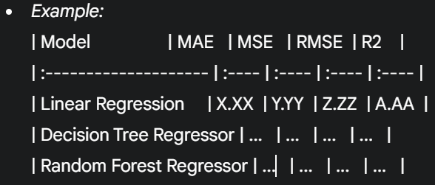
08 - Model Performance Evaluation
Metrics Explained:
Mean Absolute Error (MAE): Average absolute difference between predictions and actual values.
Mean Squared Error (MSE): Average of the squared differences. Penalizes larger errors more.
Root Mean Squared Error (RMSE): Square root of MSE, in the same units as the target variable.
R-squared (R2): Proportion of variance in the dependent variable predictable from the independent variables (how well the model fits the data).
Results Table: Present the results dictionary output clearly for all models.

Slide 10
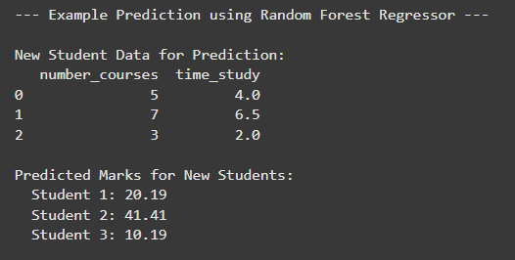
09 - Example Prediction
Predict marks Snapshot
Demonstration: the best-performing model Random Forest can predict marks for new, unseen student data.
Input Data: new_student_data DataFrame.
Predicted Output: the predicted_marks.

Slide 11
10 - Conclusions
Summary of Findings:
Successfully summarized student performance (total, average, grade).
Identified class average and topper.
Demonstrated effective prediction of marks using ML models.
Visualizations provided clear insights into the data.
Potential Future Enhancements:
Collect more features (e.g., attendance, previous academic performance).
Explore more advanced ML models (e.g., Gradient Boosting, Neural Networks).
Implement a user interface for interactive analysis and prediction.
Analyze correlation between number_courses and time_study more deeply.
Reference
Data Set : yasserh/student-marks-dataset
Git Hub:
https://github.com/VidhanThakur09/Guvi-Internship

Slide 12
Thanks
Vidhan

